Slide 1


Angular 4
Angular 4 Architecture and Components

Slide 2
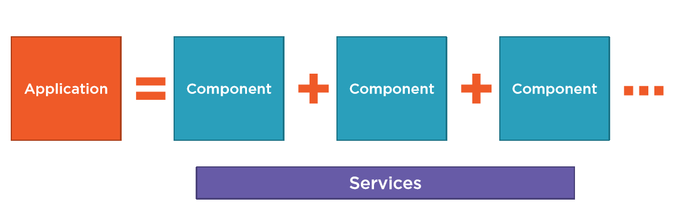
Angular Application Architecture
An application is a set of interconnected components and set of services provide functionality across them.
Components are bundled in to Modules and there can be one or more modules for an angular application
Because we have no use of modules other than bundling components, we call app as collection of components

Slide 3
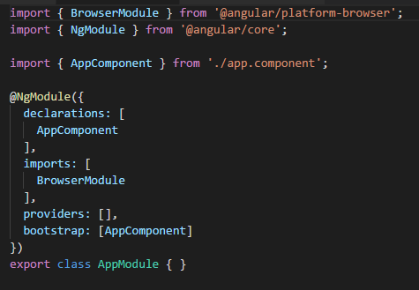
Basic Module of an Angular application
This is a sample Module written in Typescript. You may don’t know what the typescript is but you are going to find out it in later lessons. For now think of it as a Object oriented language.
Import section will import the needful files and their functions to the module. We can globally import things here.
@NgModule is a decorator and will find out later
bootstrap: [AppComponent] this will find the main AppComponent witch we look at later and runs it in the browser (the actual functionality is bit more complex . But for now let’s say that it display this component in the browser.)
Things you imported have no use until you put them in imports[] array.
Declarations are the class types—components, directives, and pipes—that you can add to an NgModule's

Slide 4
Declarations - the view classes that belong to this module. Angular has three kinds of view classes: components, directives, and pipes.(more details are on the way)
Exports - the subset of declarations that should be visible and usable in the component templates of other modules.
Imports - other modules whose exported classes are needed by component templates declared in this module.
Providers - creators of services that this module contributes to the global collection of services; they become accessible in all parts of the app.
Bootstrap - the main application view, called the root component, that hosts all other app views. Only the root module should set this bootstrap property.

Slide 5
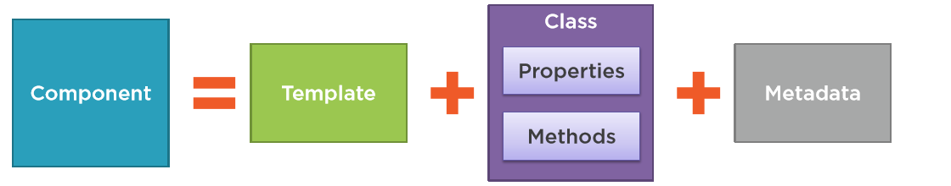
Components
Template is a html5 file or code segment that represent the view of the component. With is the part witch displays to in the UI.
Class is the code associated with the view (you may think of this as code behind file.). This has properties to hold data and methods to carrying out template functionality.
Metadata provide additional details about the component to angular transpilor . This medadata used to identify this class as an angular component.

Slide 6
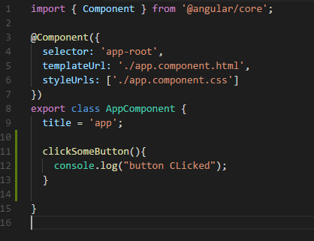
Sample Angular Component
First line will import the Component Directive from the angular core namespace.
@component is the metadata that will make this file as an angular component.
selector ,templateURL and styleUrl are the links to the view witch will implement in this component. This will represent the metadata and the template.
Rest of the file defines the code behind function

Slide 7

Classes
We declare a class using class key word just like any other programing language followed by the class name AppComponent . We follow a naming convention when naming this components.
By convention a root component has given the name AppComponent . You can give any another name but following these convention makes thing very easy to others to follow.
export key word will export this class and then other components can use this class. This will make this class publicly visible to other classes.
We have one property and one method in the class. And we will dig them later on.
Method names are camel case (first later is simple and other starting letters in the words are capital)
Title will have string data type in runtime but we can explicitly make title as string at design time

Slide 8
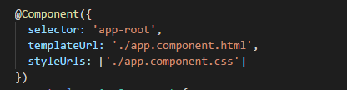

Meta data
Angular class becomes a component when we give it it’s Mata data. After then angular will knows how to construct the view and work with the class.
We make this happen by apply a function call Component and prefixed with the @ sign. So this will become an angular decorator.
@component is a built-in decorator to angular. There are lot of these EX: @NgModule
Selector is the directive name used in html template. This means where ever you put this directive (like <app-root></app-root>) angular display the template inside these tags

Slide 9
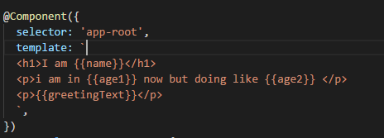
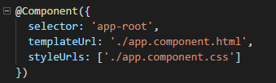
2 ways
This is different ways to define metadata. In the first case template will get from a file call app.component.html. And styleurl means styles specific to this component will get from the app.component.css.
In the second case we define template inline. Look the templateurl decorator now have changed to template.
You can use ‘’ or `` (tidle) to define inline template. When use ‘’ it limit to one line. To get multiple lines use `` (tidle) instead.
Styles can also define inline or separate file like above .

Slide 10
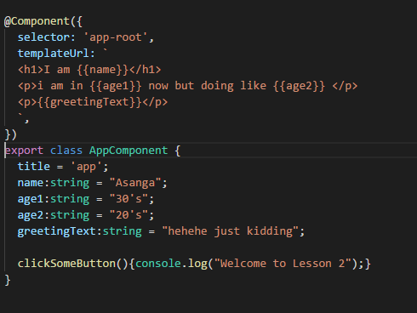
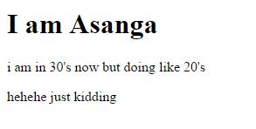
In this example there are 4 string variables and a inline template. We inject the variable to the template using {{}}.
When angular sees {{name}} this , it will look a variable name “name” in the corresponding class .if it found it will display the value inside {{}}. Otherwise it will not throw an error instead it will ignore and will not display the value.
In above code there is an error. What is it . Take a closer look and find that out

Slide 11
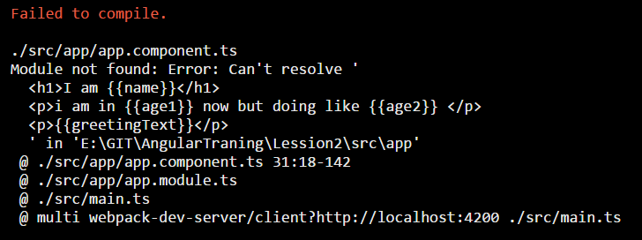
Transpile errors
In last slide there is an error. It that we miss use the templateurl instead of template. so angular will throw a very large descriptive error
Filled to compile???Really?
Angular app never compiles .they are Transpiles . So this is a mistake of angular putting compile in there
If you look at the command prompt it will display a very nice error message that you will never read till end. Don’t ever read it until you know more about angular. Instead of that read the error message on the browser. It is short in details but give clear details of the error.
In this case angular give you can’t resolve ` . It means when put templateurl angular expects a file. But there is no file in the template url. That’s why angular gave that error

Slide 12
Bootstrapping App Component
Most people misunderstand the bootstrap. This is not twitter bootstrap. This process means load and goes our angular app.
Most of the angular apps has index.html file . This is the main page of the application. It’s a plain html5 file with header body and html tags.
Angular architecture is built –in SPA style. SPA –single page application. There only have one html main page. And calling different component inside that html page will looks like to users that there are many pages in the application.
Simply put inside our index.html file we will inject the selector of our component and not the main page but certain part of the page is changed with this injection

Slide 13
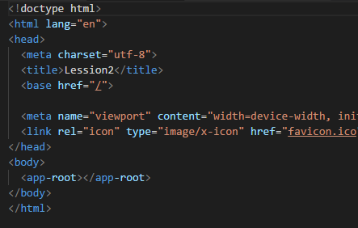
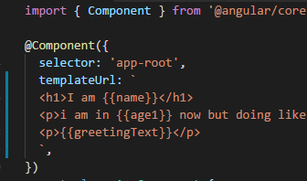
In here left side is the index.html and right side is the currespondent component. In the metadata you can see the app-root as the selector. In html file it is used like any other html tag and angular knows what it is.
What it will do is that it will get the inline content of the template and inject it in side the tags

Slide 14
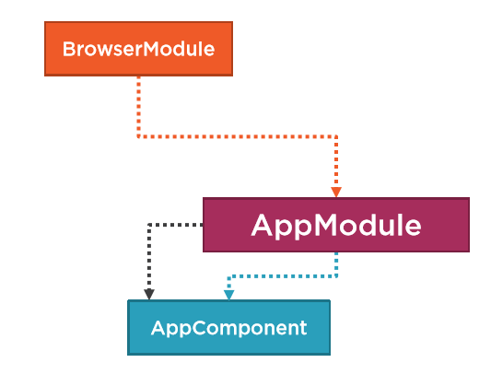
How angular knows app-root ?
Angular modules help us arrange our components.
It also give us a place to import things that can use throw-out the application.
They also provide a boundary for the application.
This module also provide us a Template Resolution Environment (TRE). It means is that when ever angular transpiler sees an selector and correspondent tag inside a html file , it will look at the app module that those are imported in module. If not angular will gave and error.
also we need this component work correctly in the browser so we load BrowserModule.

Slide 15
1

